Slide 1

Elasticsearch For Dot Net Developers
By
David Betteridge
@da_betteridge

Slide 2


Slide 3

Tonight

Slide 4
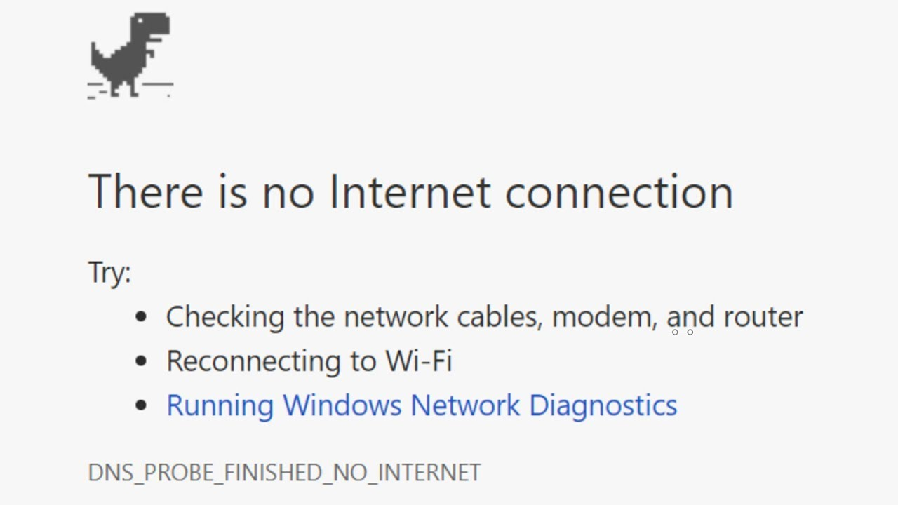


The Story

Slide 5
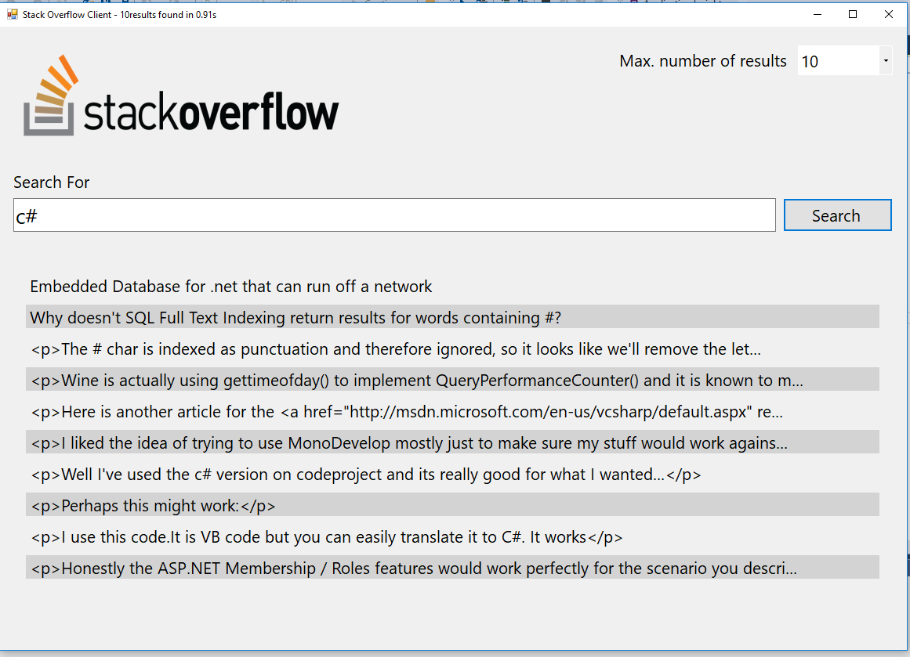
The Application

Slide 6
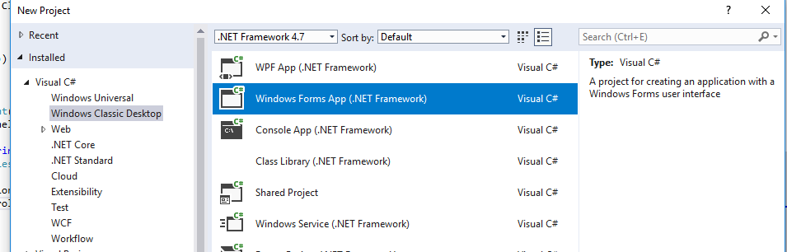

Architecture

Slide 7

Problems

Slide 8
Introducing Elastic Search
Elasticsearch is an open-source, broadly-distributable, readily-scalable, enterprise-grade search engine.
Accessible through an extensive and elaborate API, Elasticsearch can power extremely fast searches that support your data discovery applications.
Notes:
Getting started
Inverted Index
Rest API
NEST API
Bulk Import
Demo adding data
Demo search for data

Slide 9

Notes:
Elastic Search

Slide 10

Notes:
Log Stash

Slide 11

Notes:
Kibana

Slide 12

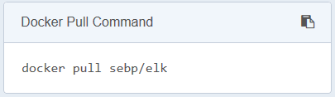
Getting Started
Notes:
docker run –p 5601:5601 –p 9200:9200 –p 5044:4044 –it -–name elk sebp/elk

Slide 13
REST
Notes:
Describe index type and id
Index/type/id id is optional
Result is created, then updated
The version number also goes up

Slide 14

Elasticsearch.Net
Install-Package Elasticsearch.Net

Slide 15

NEST
Install-Package NEST

Slide 16

NEST Client
ElasticSearch.Net
REST

Slide 17
The Application Revisited
Notes:
The elastic search version

Slide 18

Log Stash
Notes:
Centralize, Transform & Stash Your Data
Logstash is an open source, server-side data processing pipeline that ingests data from a multitude of sources simultaneously, transforms it, and then sends it to your favorite “stas
Requires the Java runtime – might be an issue on dotnet only servers.
Show config in iis manager
cd F:\logstash-6.2.2\bin
.\logstash -f ..\demo_conf
Load data
Show on map

Slide 19
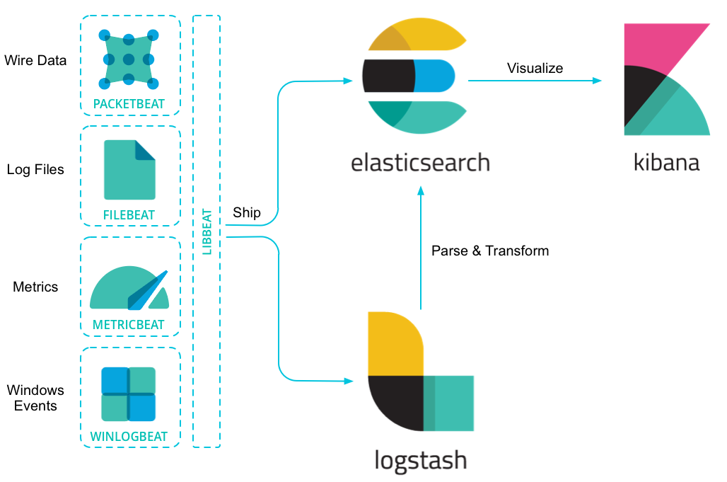
Beats

Slide 20

Kibana

Slide 21
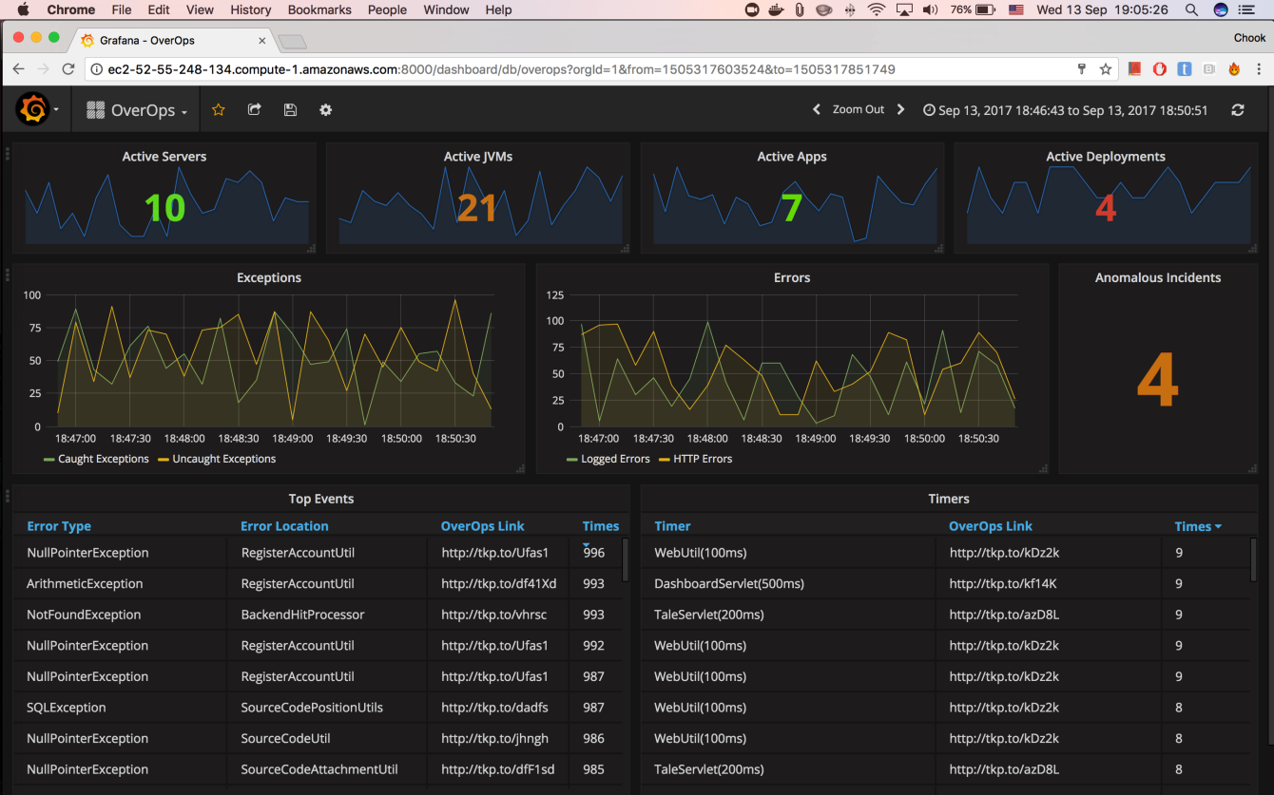
Grafana

Slide 22

Serilog

Slide 23

Security

Slide 24
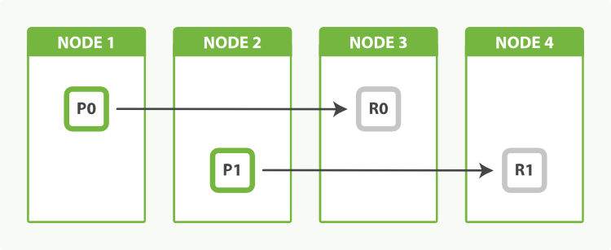
Scaling

Slide 25
Summary
We compared SQL Server to Elastic Search
Looked at various libraries to load data
Looked at some queries
Looked at some visualisation
Looked at log stash and beats
Discussed security
Discussed scaling
Questions?

